Slide 1
Traffic Prediction for Urban Planning
Fangzheng Xu
IEEE Class
Computer Science and Engineering
Shanghai Jiao Tong University
Supervised by: Kenny Q. Zhu

Slide 2
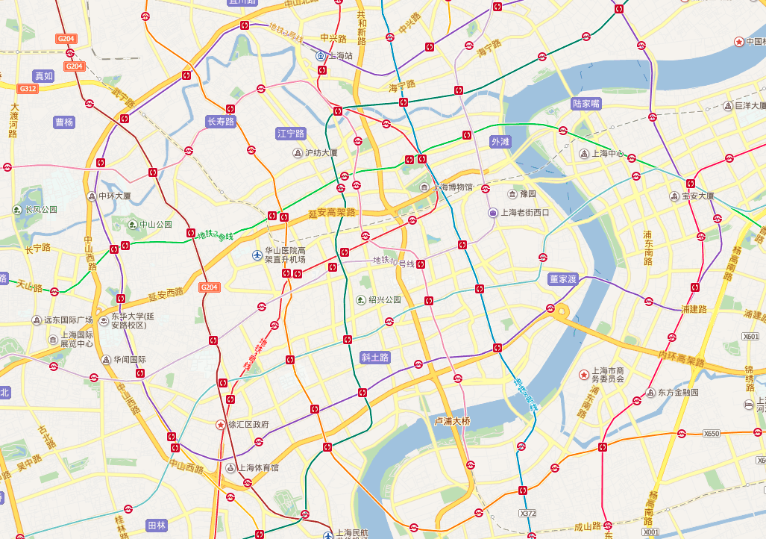
Why Traffic Prediction?
Travel Planning
Urban Planning
Transport Distribution
Notes:
Why do we need traffic prediction? It is useful for many purposes

Slide 3
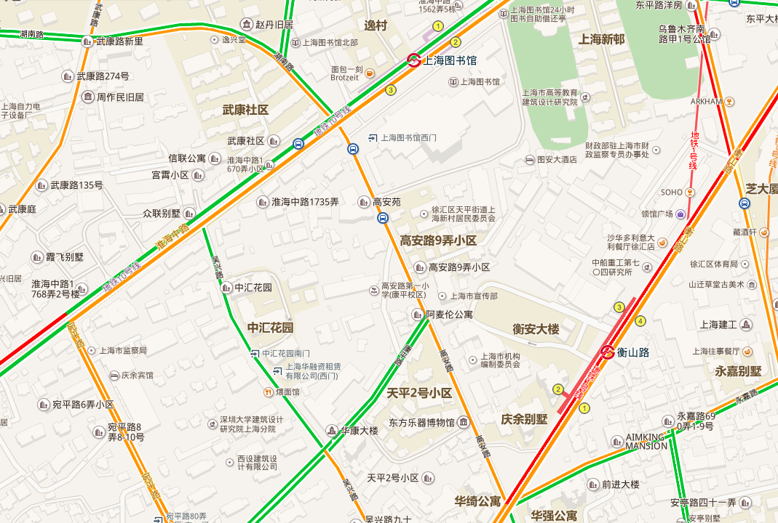
Predict traffic somewhere at future time
Now
Notes:
One of the common case of traffic prediction is temporal prediction

Slide 4
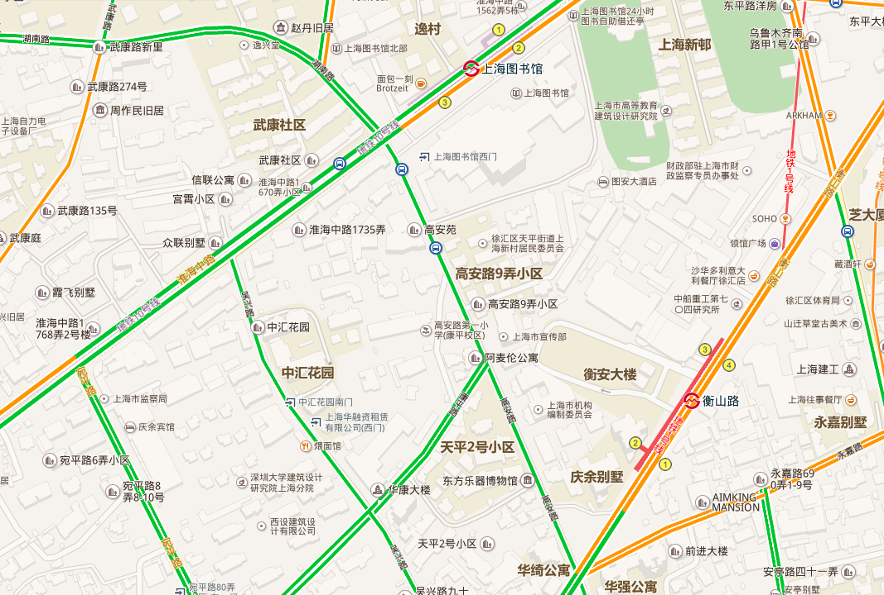
Predict traffic somewhere at future time
Predict traffic somewhere at future time
1 hour later

Slide 5
Make some urban planning changes!
Add a new road?
Notes:
Another case is about spatial prediction, like….

Slide 6
Make some urban planning changes!
Good for traffic!

Slide 7
Make some urban planning changes!
Build a new shopping mall?
?

Slide 8
Make some urban planning changes!
Cause traffic jam!
?

Slide 9
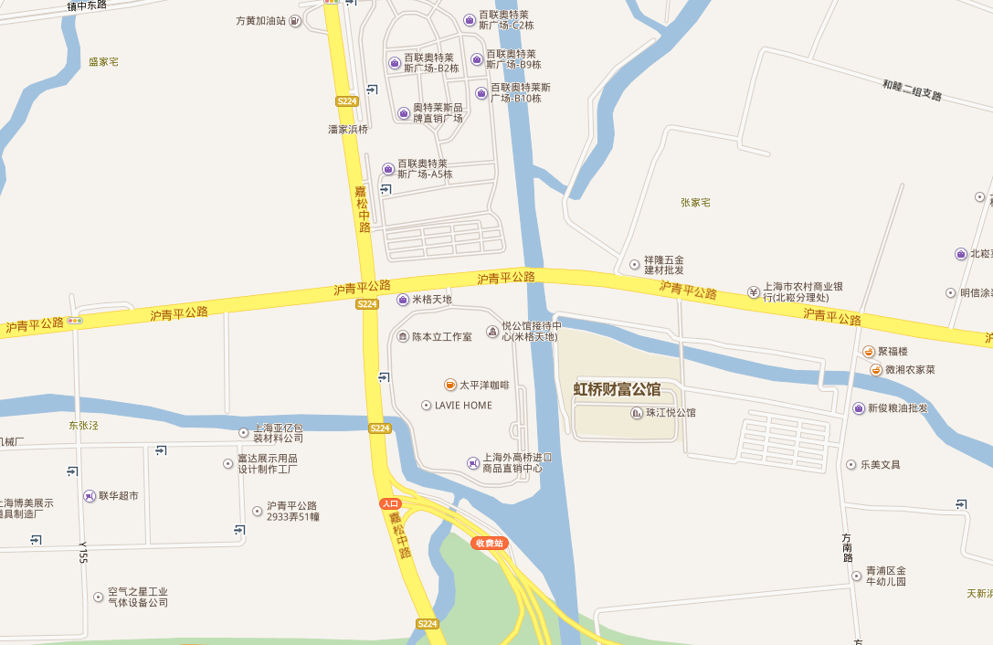
Verification of traffic on urban planning
New district
A good planning?
Notes:
Or, we can even use traffic prediction to do verification of traffic on urban planning, like what if we were given a newly designed district, and we want to figure out if ....

Slide 10
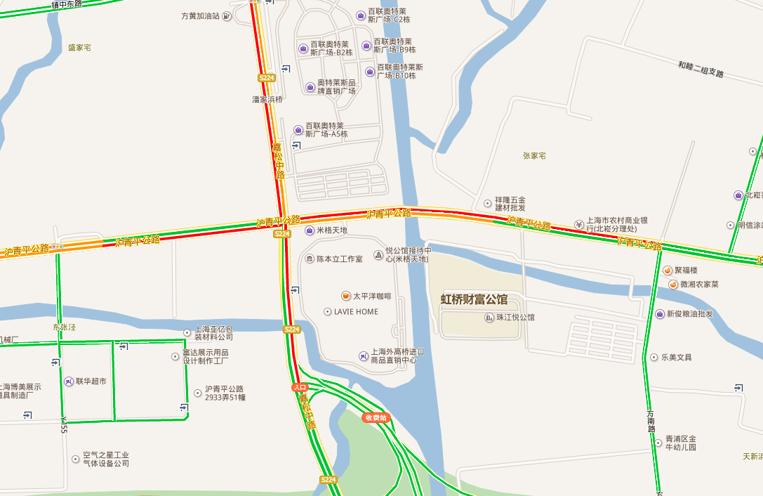
Verification of traffic on urban planning
Prone to traffic jam!

Slide 11
Our Goal
Build a system to predict traffic conditions on any roads given map of the area, time and other variables.
Input: road network map, points of interests, time, and the weather condition, etc.
Output: 4 classes at each spot: green (good), yellow (slow), red (congested) and deep red (extremely congested).
Notes:
With those important usages of traffic prediction, our goal is …

Slide 12
We need to collect data
Baidu Map seems to have all information
However…
Notes:
In order to do predictions, we first need to collect data
However there are quite a few challenges

Slide 13
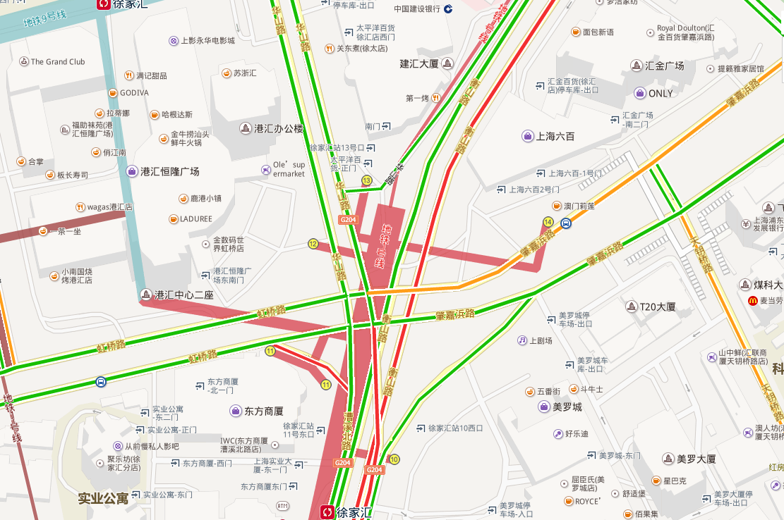
Challenges
Baidu Map
No vector map, only images
Notes:
The Baidu Map is not open data, it is only available in raster image form, not vector map data.

Slide 14
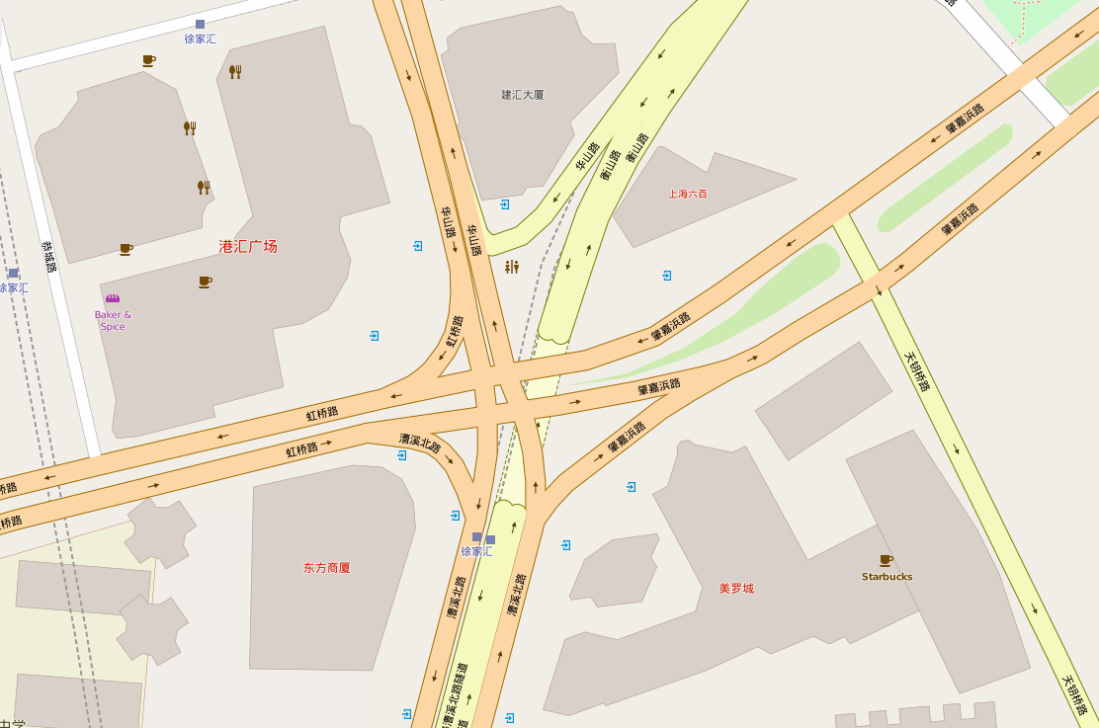
Challenges
OpenStreetMap
Vector data
We need to merge two data sources!
Lacks lots of POIs in China
No real-time traffic information
Notes:
So here we turn to OpenStreetMap which is open and free, with vector data.

Slide 15
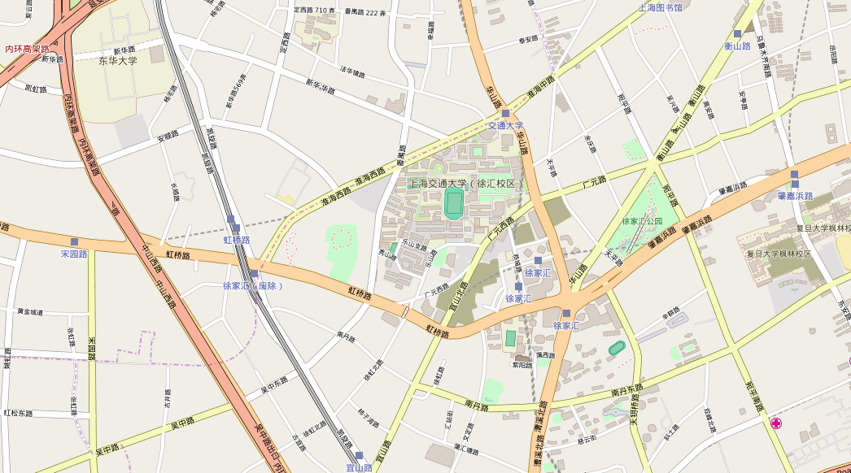
Map data from OpenStreetMap
Free and open source
Good precision
Great data schema

Slide 16
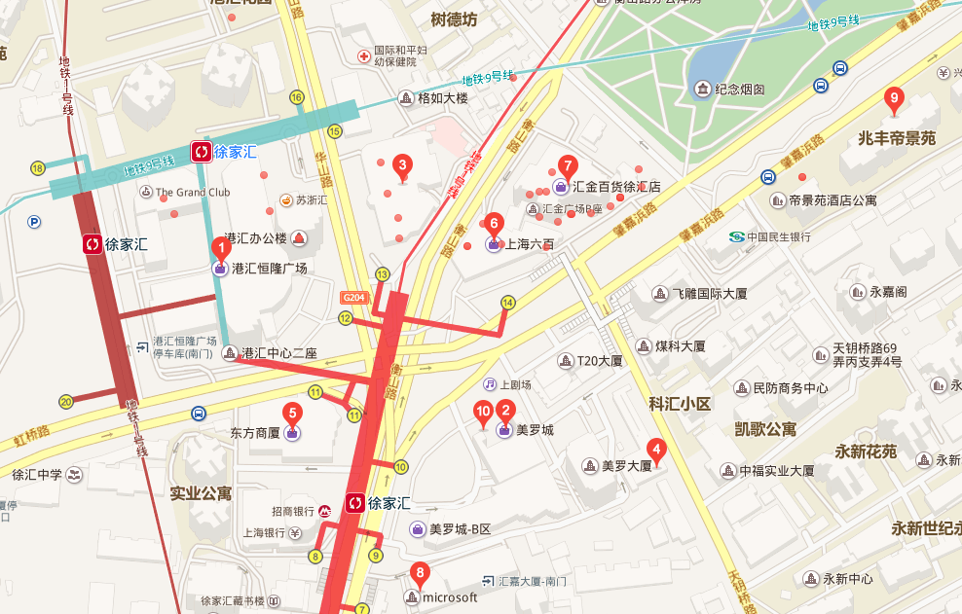
Points of Interest from Baidu Map
Recursively query and crawl
Notes:
Next, we have our poi data from queried using API and crawled from Baidu Map, like the red dots and pins here

Slide 17
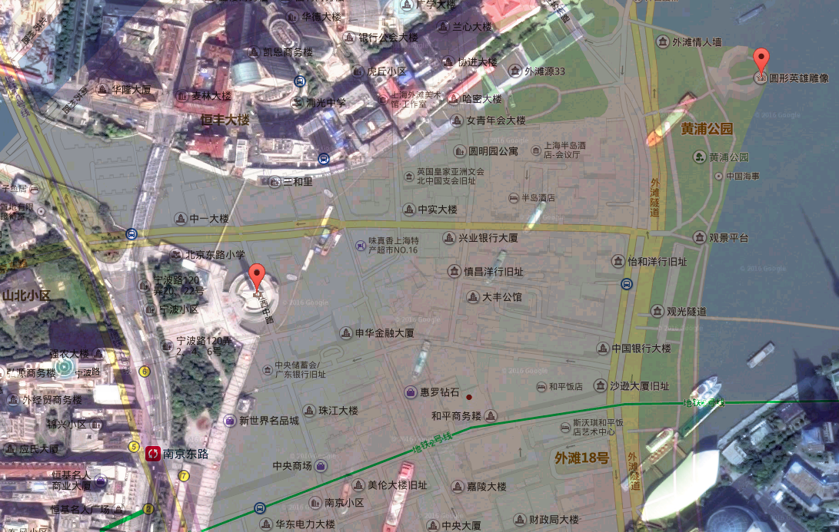
Challenges
Baidu’s distorted coordinates
BD-09
1.1 km
WGS-84
Notes:
However, merging those data is not trivial. Baidu map is known for having distorted coordinates over real GPS ones, which is OpenStreetMap
As you can see in the satellite image down below, the monument ….. And on the Baidu Map overlay above, the monument….., the world standard GPS coordinate with OpenStreetMap used is WGS-84, and Baidu Map uses its own BD-09…

Slide 18
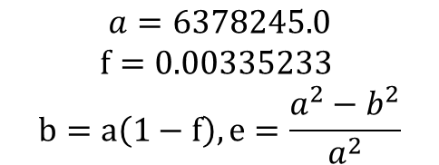
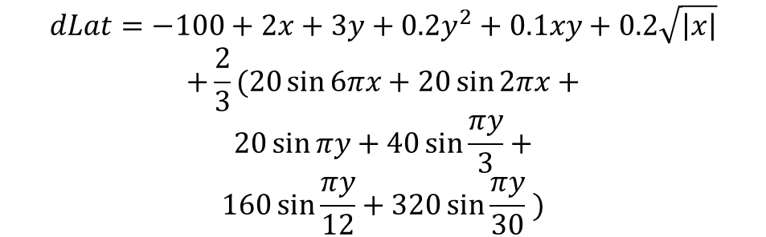

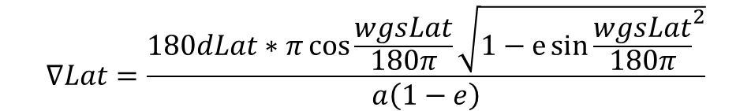
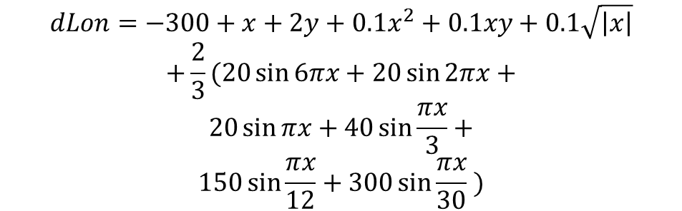
$$x=wgsLat−105, y=wgsLon−35$$
OpenStreetMap: WGS-84
$$dLat=−100+2x+3y+0.2y^{2}+0.1xy+0.2\sqrt{\left|x\right|}$$
$$+\frac{2}{3}(20\sin{6πx}+20\sin{2πx}+$$
$$20\sin{πy}+40\sin{\frac{πy}{3}}+$$
$$160\sin{\frac{πy}{12}}+320\sin{\frac{πy}{30}} )$$
Decrypt
Encrypt
Government: GCJ-02
$$dLon=−300+x+2y+0.1x^{2}+0.1xy+0.1\sqrt{\left|x\right|}$$
$$+\frac{2}{3}(20\sin{6πx}+20\sin{2πx}+$$
$$20\sin{πx}+40\sin{\frac{πx}{3}}+$$
$$150\sin{\frac{πx}{12}}+300\sin{\frac{πx}{30}} )$$
Decrypt
Encrypt
Baidu Map: BD-09
$$∇Lat=\frac{180dLat∗π\cos{\frac{wgsLat}{180π}}\sqrt{1−e{\sin{\frac{wgsLat}{180π}}}^{2}}}{a\left(1−e\right)}$$
$$a=6378245.0$$
$$f=0.00335233$$
$$b=a\left(1−f\right), e=\frac{a^{2}−b^{2}}{a^{2}}$$
$$∇Lat=\frac{180dLon∗π\sqrt[\frac{3}{2}]{1−e{\sin{\frac{wgsLat}{180π}}}^{2}}}{a}$$
Reverse: Numerical Approximation!
Accuracy: ~0.5m
Notes:
And we need to solve the problem in the difference of coordinates, we have a public secret encryption function from WGS to BD, while extremely complex in its form. We need to calculate Baidu Coordinates back to original ones…

Slide 19
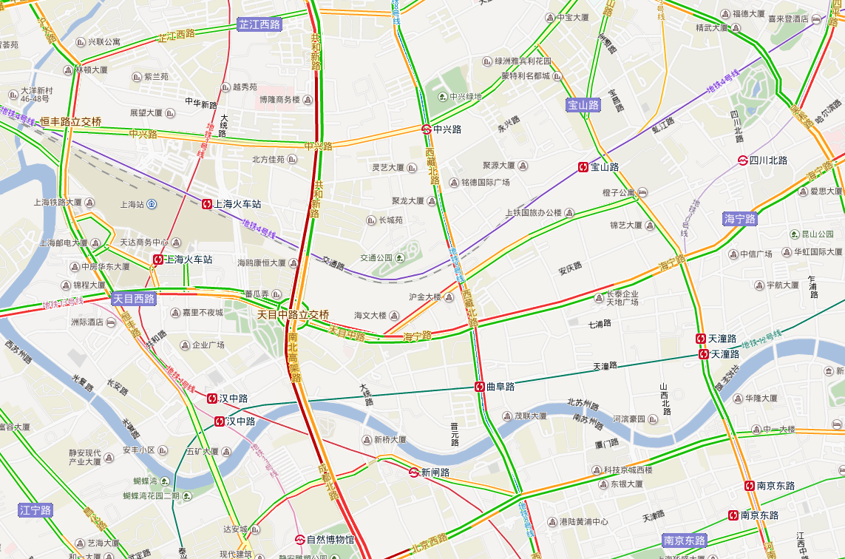
Traffic data from Baidu Map
Yellow – Slow
Deep Red – Extremely Congested
Red – Congested
Green - Good
Notes:
Afterwards, we have to get traffic data

Slide 20
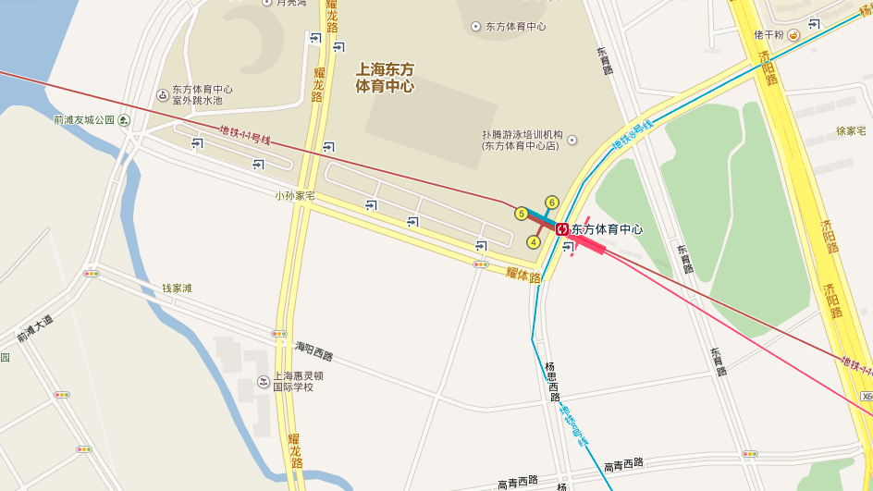
Baidu Map
Notes:
Here is a small area in baidu map

Slide 21

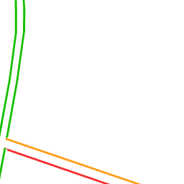

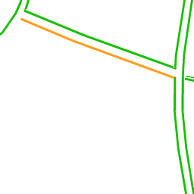
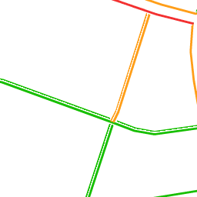
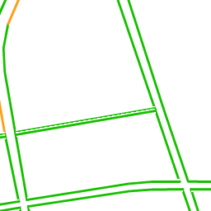
With traffic
Notes:
And with real-time live traffic data, we..

Slide 22
Traffic tile
Notes:
Crawl, extract and combine traffic tiles to one

Slide 23
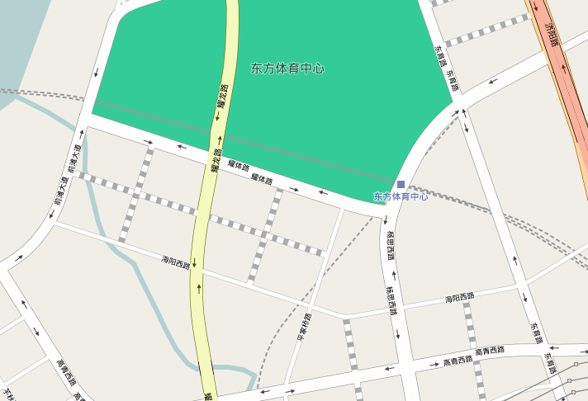
With OpenStreetMap
After coordinate transform
Still no exact match!
Notes:
And overlay with openstreetmap, after coordinate transform.
Let’s take a closer look..

Slide 24
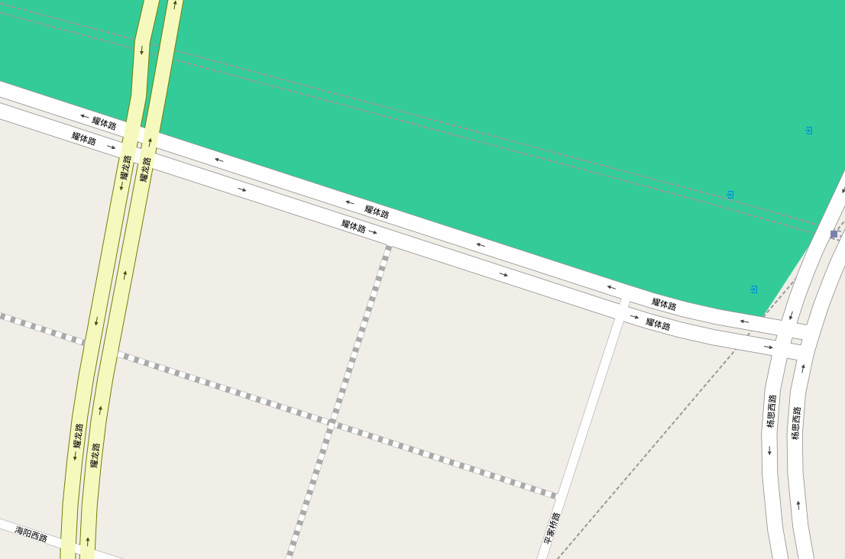
OpenStreetMap nodes transformed into coordinates
Searched color pixels in Baidu Traffic image
Notes:
Black dot is the OpenStreetMap node transformed to coordinates of Baidu Map, and shown on the traffic tile
We search from the black node to search both directions for colored pixels that represent traffic situation,
The black arrows show the direction of search is perpendicular to the way of road, and we found each of them on two sides,
While this one, even though it is not a exact match, we can still find two pixels representing traffic situation on both directions of this two-way road

Slide 25
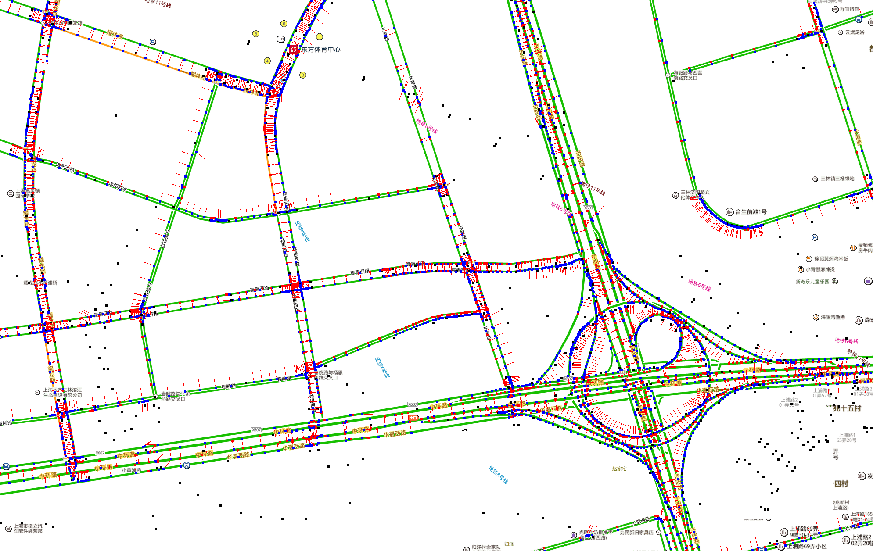
Combine & Intercept – Our program

Slide 26
OSM nodes mapped to Baidu Map coordinate
Color label pixel searched on both direction

Slide 27
Feature Engineering
Local spatial features
Global spatial features
Other more implicit features

Slide 28
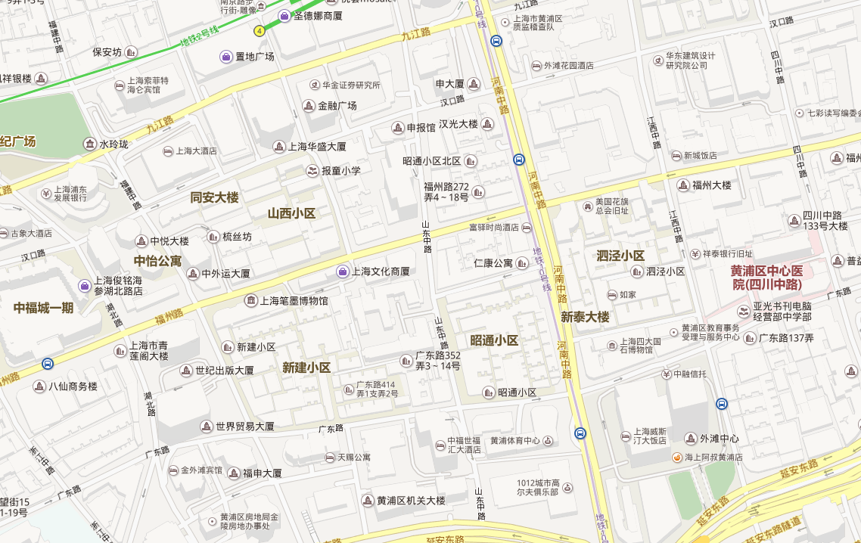
Local spatial features
Road Type
Tertiary road
Secondary road
Primary road
Notes:
As for local spatial features, one example is road type, like …

Slide 29
Local spatial features
Road network density
Average distance between adjacent crossroads in both direction

Slide 30





Local spatial features
POI density of each type
Also consider adjacent crossroads in both direction

Slide 31
Global spatial features
Overview of traffic flows in large urban perspective.
Reflection of commuters and driver’s thoughts and behaviors.

Slide 32
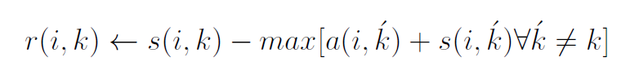
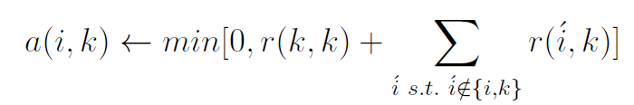
Global spatial features
Popularity and category inferred from numbers of check-ins on Dianping and Weibo.
Cluster POIs by Affinity Propagation algorithm, which chooses the number of clusters based on the data:
Responsibility: Sample k should be exemplar of i.
Availability: Sample i should choose k as its exemplar.

Slide 33
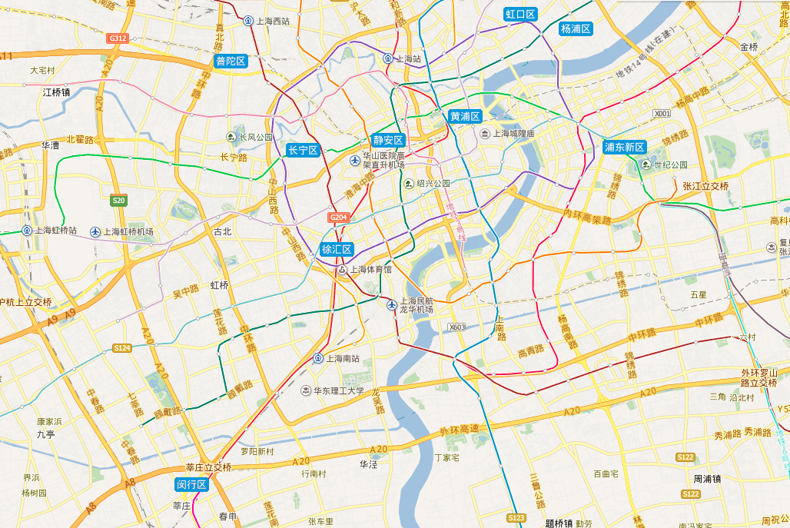
POI clusters – by popularity and type
Keys:
Commercial
Workplace
Residential
Notes:
Next we need to calculate all the routing between any two of the functional areas

Slide 34
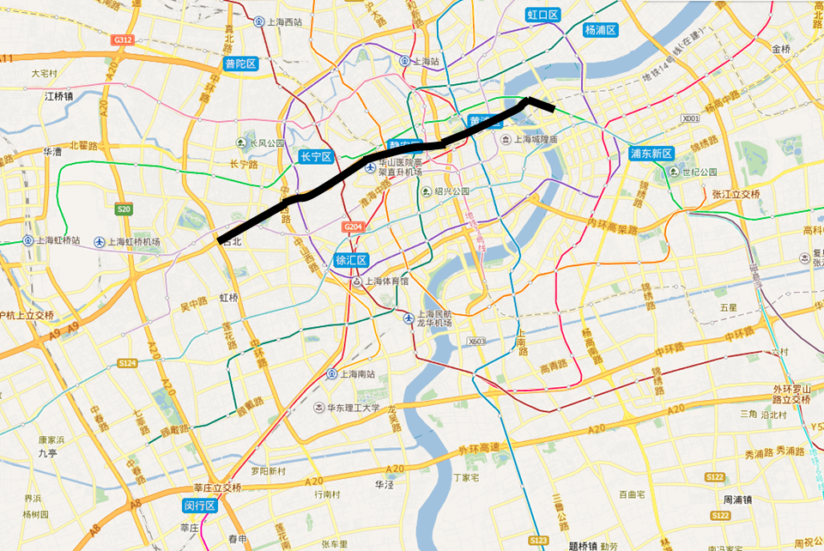
Routing between any two functional areas
Popular way choice feature on passed nodes
Calculated using A* algorithm on our OSM road network database
Notes:
All the nodes passed by such route will have a feature set called popular way choice, like those three red dots shown here.
These features reflect that whether a node or way is popular choice for people to drive from and to all kinds of places, which may cause congestion in general.

Slide 35
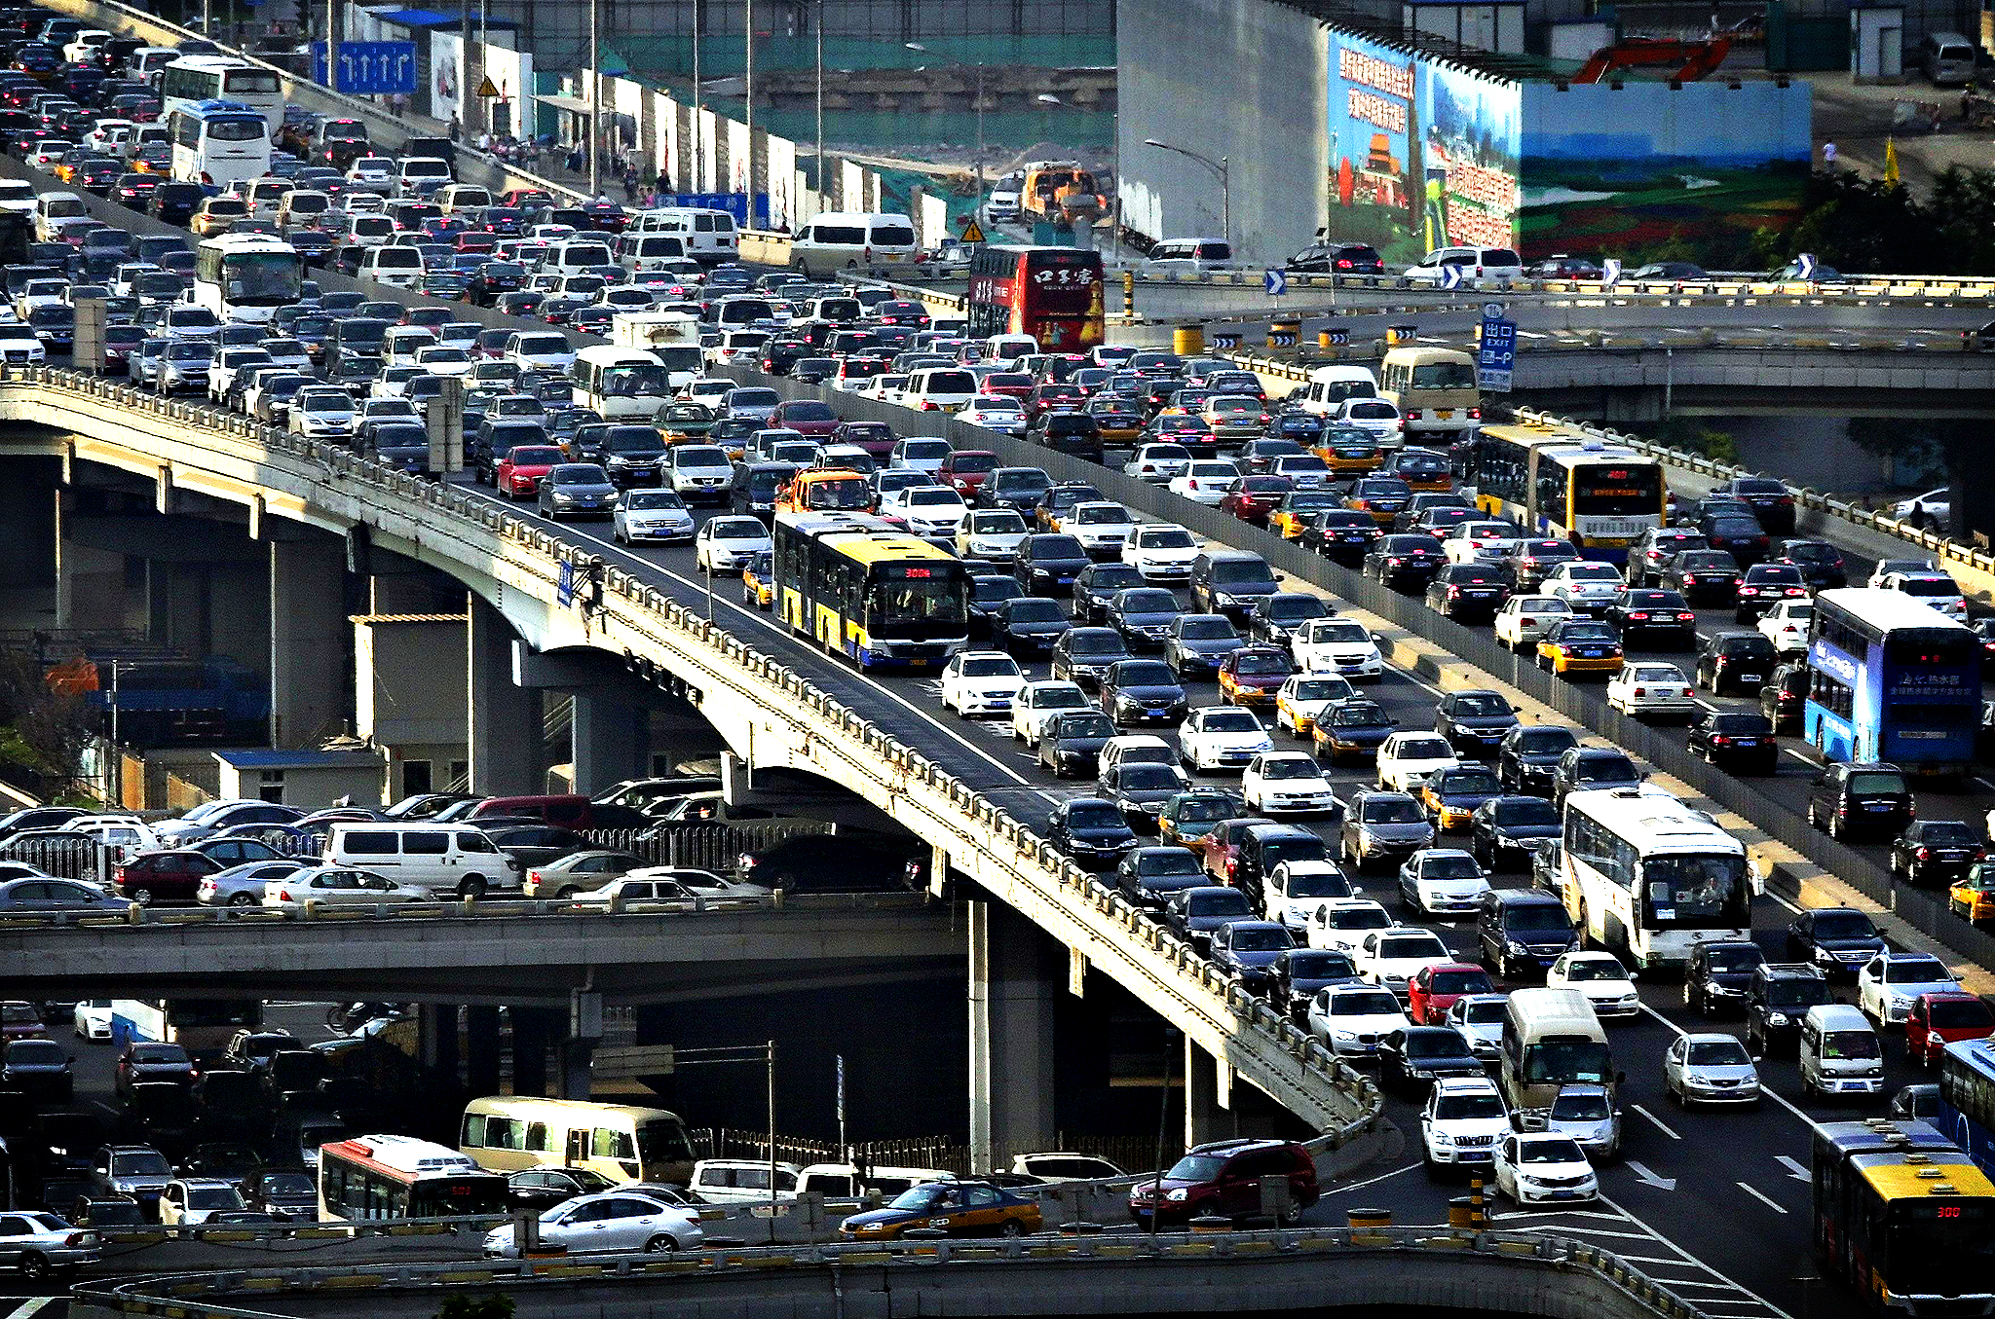
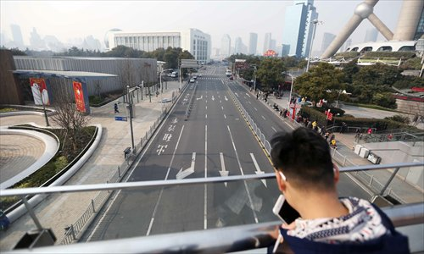


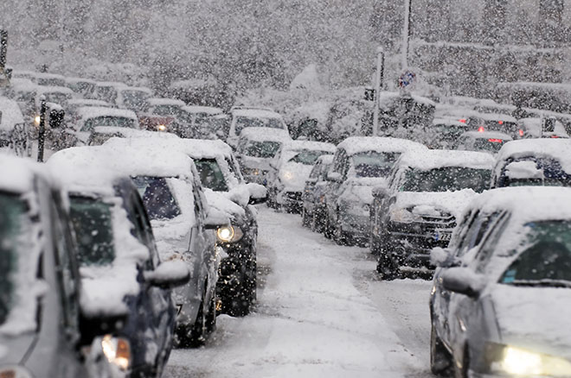
What else related to the traffic
Time of the day
Day of the week
Rental price
Weather condition
Weather condition

Slide 36
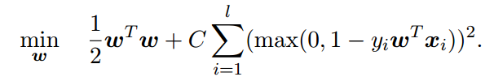
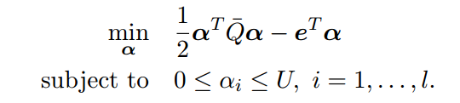
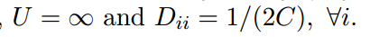
Training - Linear SVM
Categorical features to binary
Scale features to same range to normalize
Uses L2-regularized L2-loss SVC
Primal:
Dual:
Notes:
And this is the problem to solve

Slide 37
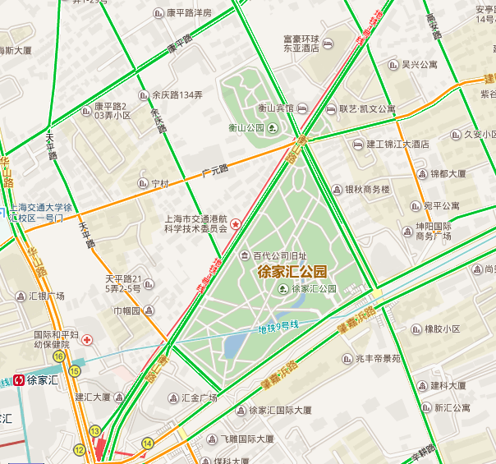
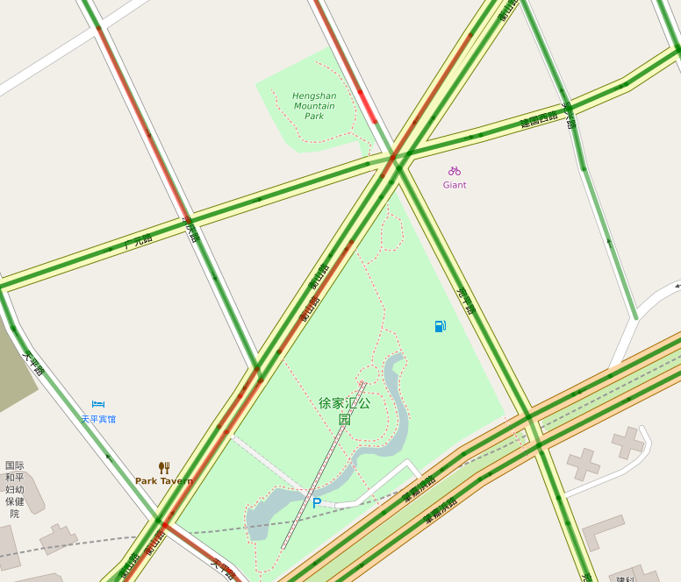
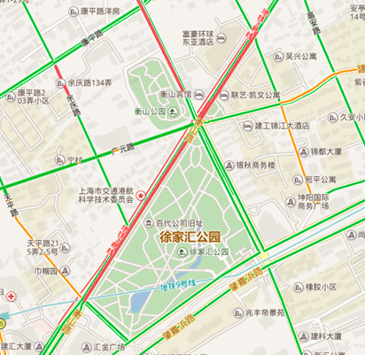
Comparison test
Baidu Map
Ours
Real Traffic
Calculate prediction accuracy against live traffic
Notes:
After the model is trained using SVM, we test our result against baidu map.
As you can see, on the left-hand side, it is the prediction result of Baidu Map, and on the right-hand side, is the prediction result of Our system on top of OpenStreetMap. We compare those predictions with the real time live traffic from Baidu Map, and it turns out that ours is actually closer prediction than Baidu

Slide 38
Baidu Map’s overall accuracy: 82.7%
Our system’s overall accuracy: 86.7%
Notes:
As for test result, for a total time period of over 4 days, our prediction accuracy is consistently higher than Baidu Map prediction, especially in those time periods that Baidu performs bad, like rush hours 6-7pm.
Our accuracy is 86.7%, 4% higher than baidu.

Slide 39
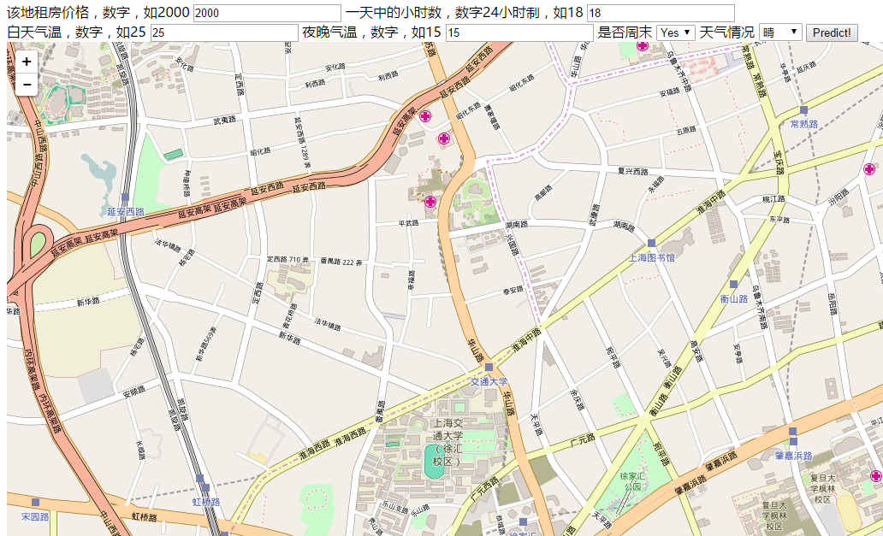
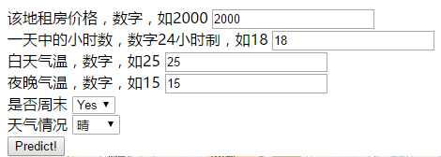
Demo showcase
Available at http://adapt.seiee.sjtu.edu.cn:8080/traffic/
Notes:
We also developed a web demo which…

Slide 40
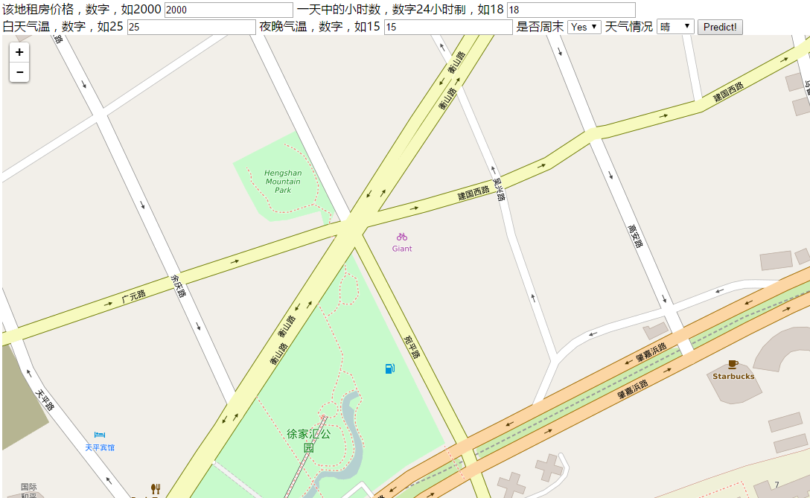

Slide 41
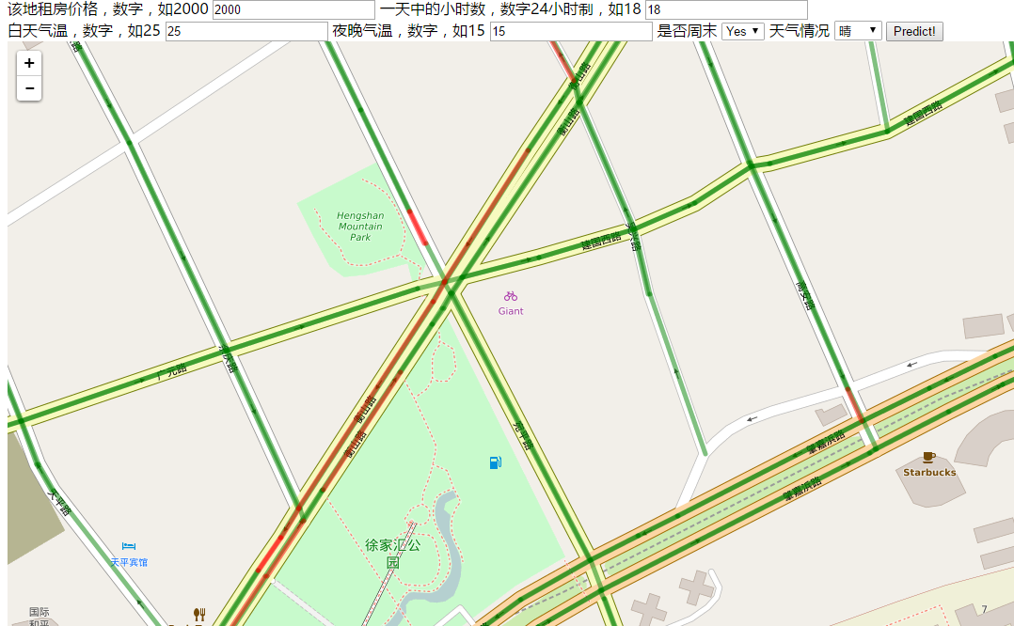
Weekend, Sunny

Slide 42
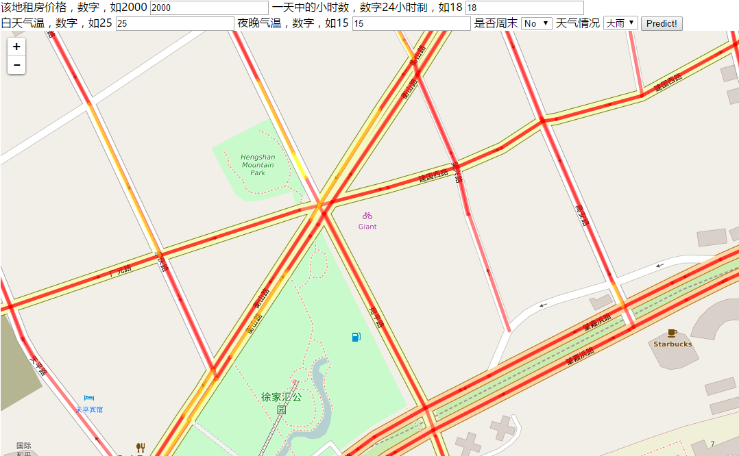
Weekday, Rush hour, Heavy Rain
Notes:
It’s overall congested

Slide 43
Conclusion
Solved challenges in data collection and feature engineering.
Achieved prediction accuracy of 0.87, outperforming Baidu Map.
Developed a web demo
To be submitted to ACM SIGSPATIAL 2016
Notes:
In conclusion…

Slide 44
Thanks!

Slide 45
Issues and future work
Data imbalance problem still affects the result, as the prediction rate of heavy traffic classes are relatively low.
To try new techniques and models like ensemble methods and decision trees to tackle the problem, since it is hard for linear SVM to classify such extreme imbalances.
Also consider from other perspectives of the problem like anomaly detection.

Slide 46
Training process
Class | #Occurrence | Percentage | Weight
Green | 2197252 | 0.90953 | 1
Yellow | 176517 | 0.07306 | 14
Red | 40629 | 0.01681 | 59
Deep Red | 1105 | 0.00046 | 2186
Extract features into specific format
Represent categorical features in binary form
Scale and normalize the value range to [0, 1]
Feed into LIBLINEAR to train the linear SVM model
Using class weights to compensate imbalance
Using primal L2-regularized L2-loss SVC as solver

Slide 47
Test result evaluation
Class | F1 Score
Green | 0.93
Yellow | 0.14
Red | 0.09
Deep Red | 0.01
Avg / Total | 0.87
Test data range: May 28 – June 1
Overall accuracy is good and predicts good at green class
Prediction is not done well for rare and severe traffic jams
Effects of data imbalance on model training

